Slide 1
PREDICTING LENGTH
OF STAY IN A NEONATAL
INTENSIVE CARE UNIT
Using Machine Learning

Slide 2

Introduction
What is a Neonatal Intensive Care Unit (NICU)?
Specialized hospital unit for newborns needing intensive medical care
Cares for:
Premature infants (born before 37 weeks)
Infants with low birth weights or serious health conditions
Provides advanced technology and continuous monitoring
Level of care depends of infant risk:
Lower risk ⟶ 1 nurse for 2–3 infants
Moderate risk ⟶ 1 nurse for 1–2 infants
Higher risk ⟶ 1 nurse for 1 infant
01
Notes:
A NICU is a specialized hospital unit that provides intensive care for premature or critically ill newborns.
These infants often require advanced technology and constant monitoring.
The level of care depends on how at-risk the infant is, which also affects staffing. For example, higher-risk infants may require a 1-to-1 ratio of one nurse per infant.

Slide 3

Research Question
Which modeling technique best predicts NICU length of stay?
Why Predict Length of Stay?
Reflects infant health and recovery
Impacts hospital resources and staffing
Supports clinical decision-making and planning
Helps identify high-risk infants early
02
Notes:
My research focuses on determining which modeling technique best predicts NICU length of stay.
Length of stay is important because it reflects both the health of the infant and the level of care they require.
It also has a major impact on hospital resources, including, as I mentioned earlier, staffing and bed availability.
Overall, being able to predict length of stay can help hospitals plan more effectively and identify high-risk infants earlier.

Slide 4

Dataset Overview
De-identified NICU data from Duke University Hospital
Originally collected for a NICU simulation model
Each observation represents one infant
Response: Length of stay (days)
Predictors:
Gestational age, birth weight
Demographics (gender, race, inborn status)
Neonatal complications (IVH, ROP, NEC, PDA)
03
Notes:
The dataset I used consists of de-identified NICU patient data from Duke University Hospital.
It was originally collected for a NICU simulation model, which Dr. Lada was actually involved in during her time at SAS.
Each observation represents one infant, and the response variable in this case is length of stay, which is measured in days spent in the NICU.
The dataset includes several predictors, including clinical variables like gestational age and birth weight, demographic information, and major neonatal complications such as IVH, ROP, NEC, and PDA.
These include conditions like bleeding in the brain, abnormal blood vessel development in the eye, a serious intestinal disease, and a heart condition affecting blood flow.

Slide 5
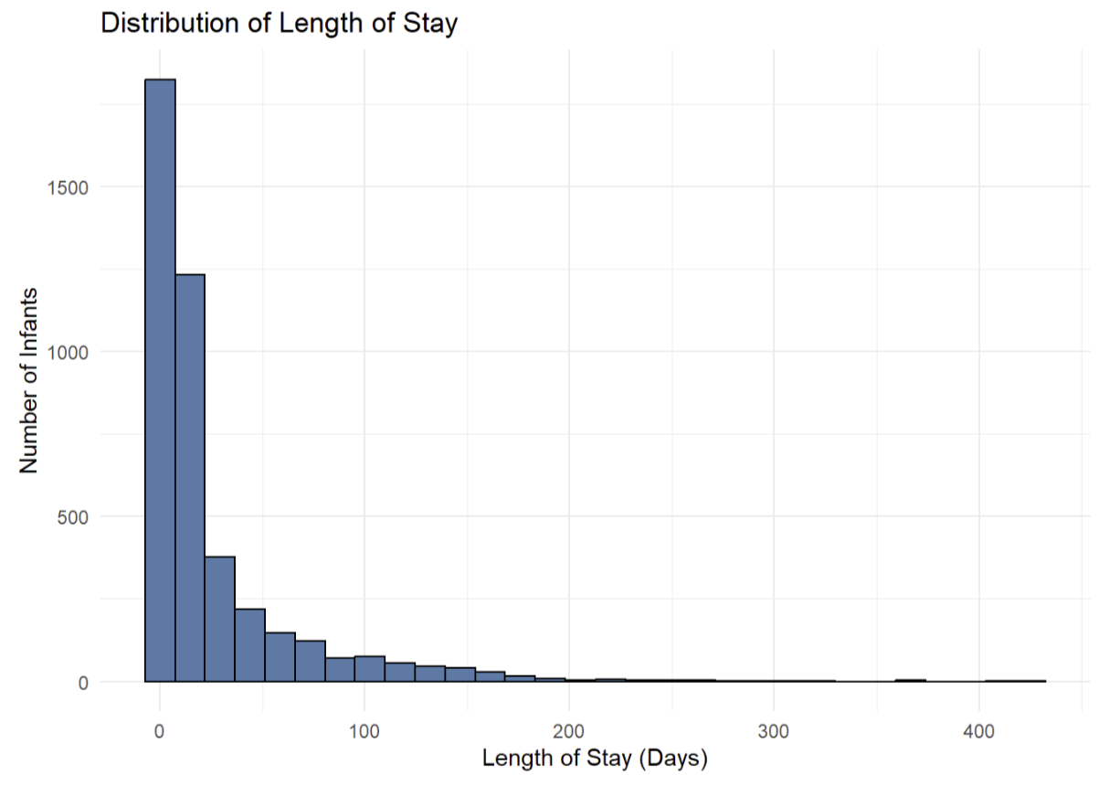
Exploratory Data Analysis
Length of stay is strongly right-skewed
Most infants have relatively short stays
Small number of infants have very long stays (outliers)
Median stay ≈ 9 days
04
Notes:
The first visualization I created shows the distribution of my response variable, length of stay.
As you can see, it is strongly right-skewed, meaning most infants have relatively short stays, which is ultimately the goal.
However, there are some infants with much longer stays, known as outliers, which create this skew.
The median length of stay is around 9 days, which gives a better sense of a typical stay than the mean due to these extreme values.

Slide 6
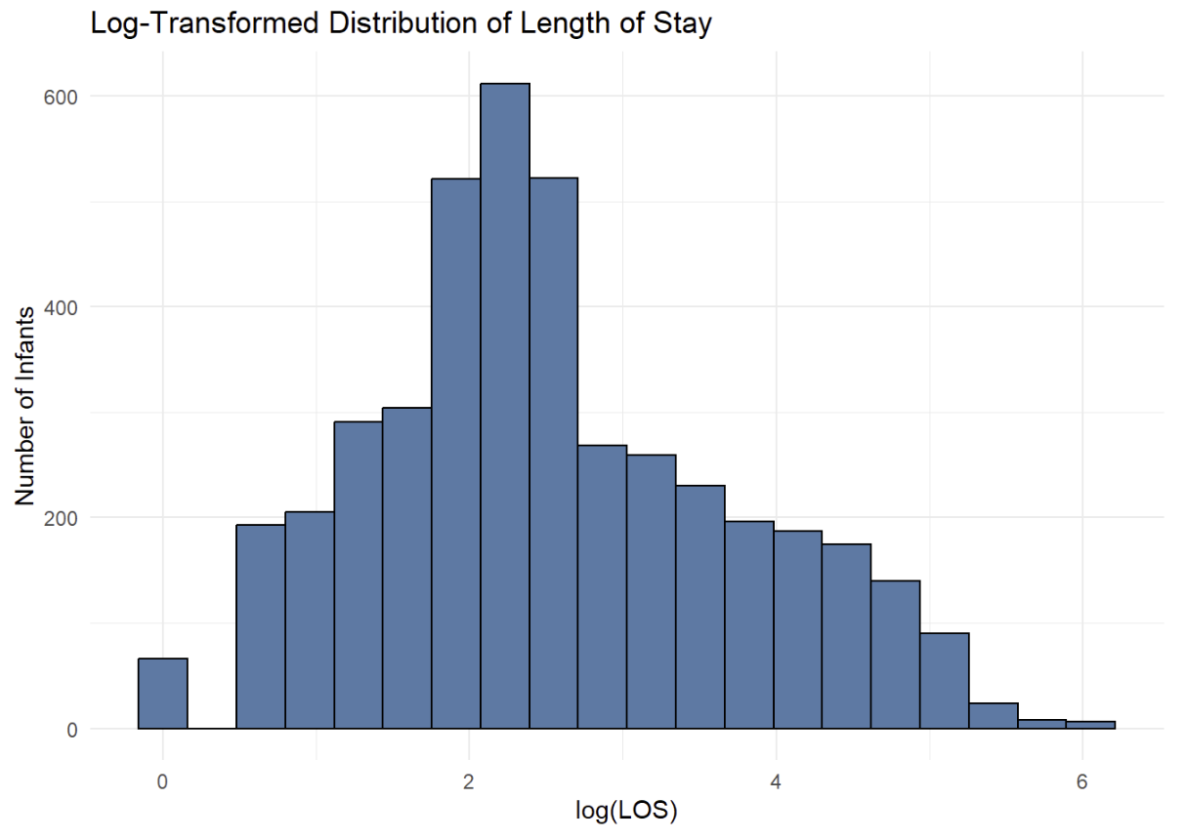
Exploratory Data Analysis
Log transformation applied to reduce right-skew
Resulting distribution is more balanced and suitable for modeling
05
Notes:
Because the distribution of length of stay was strongly right-skewed, I applied a log transformation to the data.
This transformation helps reduce the impact of extreme values and makes the distribution more balanced.
As you can see, the log-transformed data is much more symmetric and easier to work with.
This is important because many modeling techniques perform better when the data is more normally distributed.

Slide 7
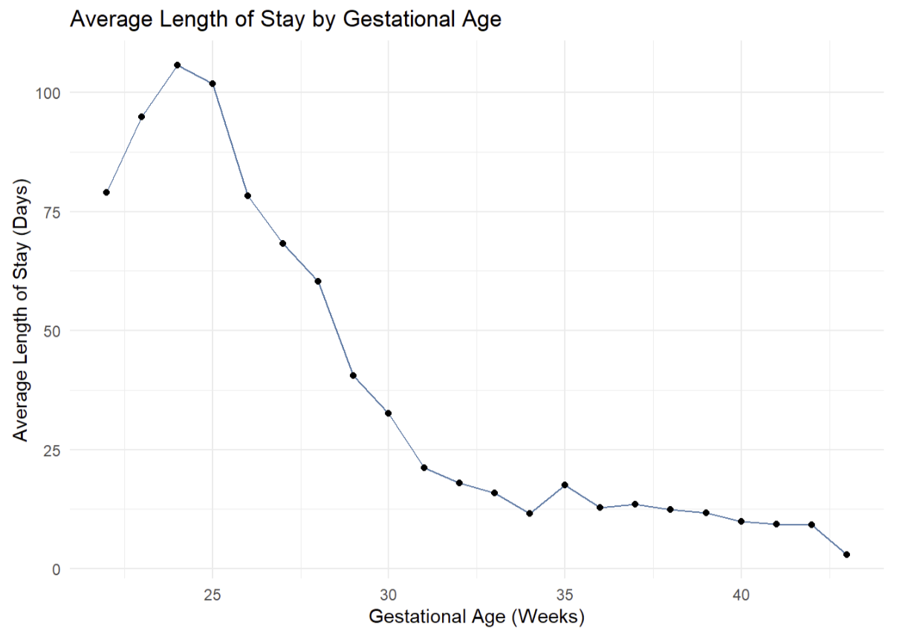
Exploratory Data Analysis
Average length of stay is highest at the earliest gestational ages
Peak occurs around 24 weeks
Length of stay decreases steadily as gestational age increases
Infants born closer to full term have shorter stays.
Premature infants experience longer stays due to increased medical complexity
06
Notes:
One of the strongest relationships I found was between gestational age and length of stay.
As you can see, the average length of stay is highest at the earliest gestational ages, with a peak around 24 weeks.
As gestational age increases, length of stay decreases steadily.
This shows that infants born closer to full term tend to have shorter hospital stays.
In contrast, more premature infants experience longer stays due to increased medical complexity and the need for more intensive care.

Slide 8

Clustering Approach
Used k-means clustering to group similar patients
Identified 4 groups:
Extremely premature
Very premature
Moderately premature
Near-term
Groups based on:
Gestational age
Birth weight
Neonatal complications
Variables standardized before clustering
07
Notes:
After exploring patterns in the data, I used a clustering method to group infants with similar characteristics.
This approach groups patients based on similarities in things like gestational age, birth weight, and clinical conditions.
I identified four main groups, ranging from extremely premature infants to those born closer to full term.
Before clustering, the variables were standardized so that no single variable had more influence than others.
I also used a method to determine the appropriate number of groups, which resulted in four clusters.

Slide 9
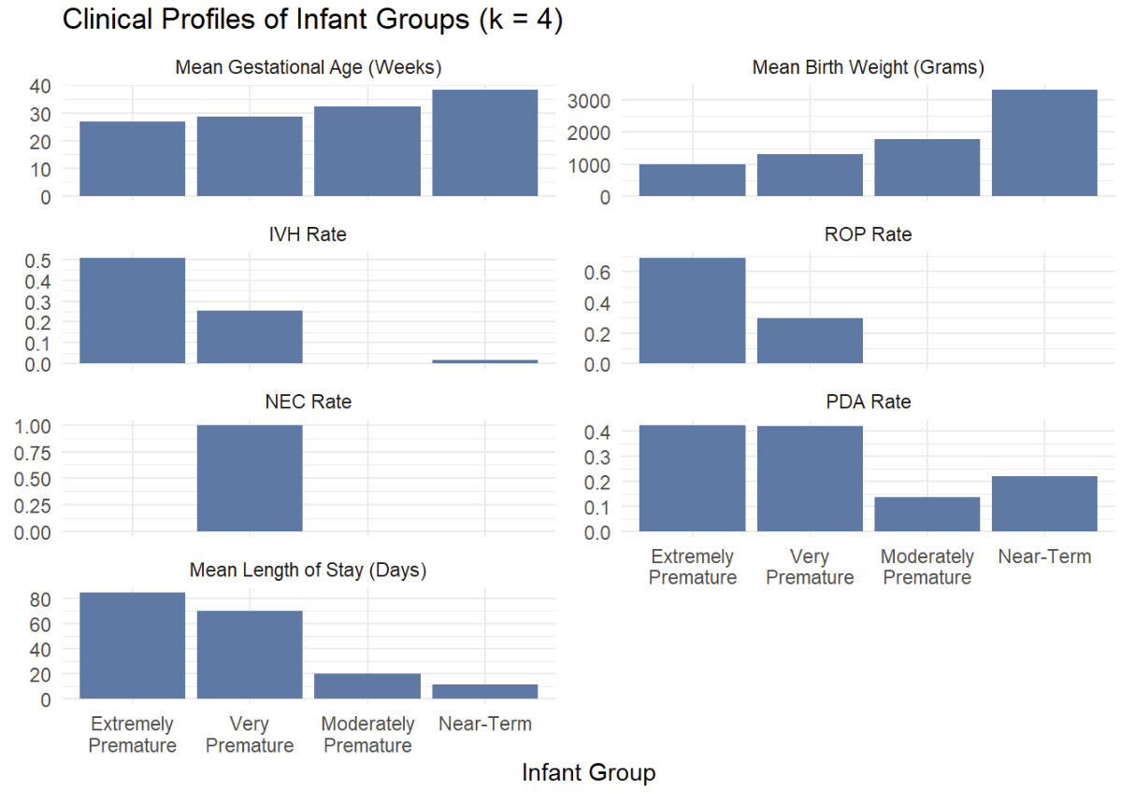
Clustering Results
Extremely and very premature infants:
Lower gestational age
Lower birth weight
Higher complication rates
Longer NICU stays
Clear relationship between prematurity and outcomes
08
Notes:
These results show clear differences between the four groups identified through clustering.
Infants in the extremely and very premature groups have lower gestational ages and birth weights, along with higher complication rates. As a result, they also experience longer NICU stays.
In contrast, infants born closer to full term tend to have fewer complications and much shorter stays.
Overall, this highlights a strong relationship between prematurity and clinical outcomes. These patterns are consistent with what we observed earlier in the exploratory analysis.

Slide 10

Statistical Methods
Before Modeling:
Data split into:
80% training
20% testing
Two models used to predict length of stay:
Log-linear regression
Random forest
09
Notes:
After identifying patterns in the data, I moved on to building predictive models.
First, I split the data into training and testing sets. The training data is used to build the model, while the testing data is used to evaluate how well it performs on new, unseen data. This helps ensure that the model is not just memorizing the data, but can actually make accurate predictions.
I then used two different statistical methods: a log-linear regression model and a random forest model. The log-linear regression is a simpler, more traditional model, while the random forest is more flexible and can capture more complex patterns.

Slide 11
Model Validation
Model accuracy evaluated using RMSE (days)
Higher RMSE = less accurate predictions
Median length of stay ≈ 9 days
Initial models show high prediction error
Model | RMSE (Days)
Log-Linear Regression | 31
Random Forest | 29.4
10
Notes:
To evaluate model performance, I used root mean squared error, which measures how far predictions are from the actual values, in days. Lower values indicate better accuracy.
For context, we saw that the median length of stay in this dataset is about 9 days.
However, the models had errors around 30 days, which is quite high compared to a typical stay.
This indicates that the models were not very accurate when using the full dataset.

Slide 12
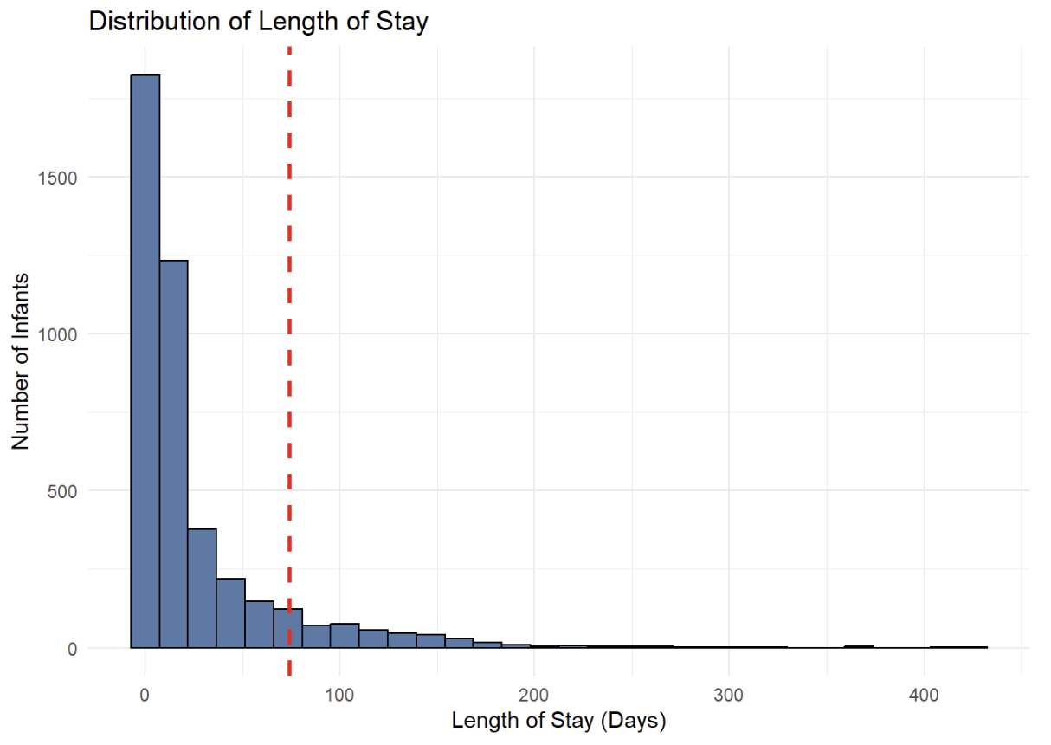
90th Percentile Restriction
Small number of infants had very long stays
These extreme values impacted model performance
Restricted data to 90th percentile (≤ 73 days)
Models re-evaluated on restricted data
11
Notes:
The infants with very long stays were heavily influencing the models and making predictions less accurate.
To address this, I restricted the dataset to the 90th percentile, which corresponds to stays of 73 days or less.
I then re-ran the models on this restricted dataset to see if performance improved.

Slide 13
Model Validation
Model | RMSE (Days)
Log-Linear Regression (Full Data) | 31
Log-Linear Regression (90th Percentile) | 12.5
Random Forest (Full Data) | 29.4
Random Forest (90th Percentile) | 11.1
Random forest produced lower prediction error than log-linear regression
Model performance improved after restricting to the 90th percentile
Best model: Random forest (11.1 days)
12
Notes:
After restricting the dataset to remove extreme values, model performance improved significantly.
Both models showed lower prediction error, but the random forest consistently performed better than the log-linear regression.
The best result came from the random forest model on the restricted dataset, with an error of about 11 days. Which is a substantial improvement compared to the initial error of around 30 days.

Slide 14

Conclusion
Random forest produced the most accurate predictions
Model performance improved after reducing extreme values
Key factors influencing length of stay:
Gestational age
Birth weight
Neonatal complications
Clustering revealed distinct groups based on prematurity
Results can support:
Hospital resource planning
Clinical decision-making
13
Notes:
Overall, the random forest model worked the best for predicting length of stay and it improved even more after removing the outliers.
In general, the results support that more premature and higher-risk infants tend to stay in the NICU longer.
This kind of analysis could help hospitals better understand what to expect and plan accordingly.

